Slide 1

Command Line Programs
M1-D5
Participate! The more engagement the better! You are NEVER interrupting me!

Slide 2
Objectives
Standard I/O
System.in/System.out
Parsing user input into primitive data types (int, long, etc)
Introduction to the Scanner class
Building and running command line applications

Slide 3
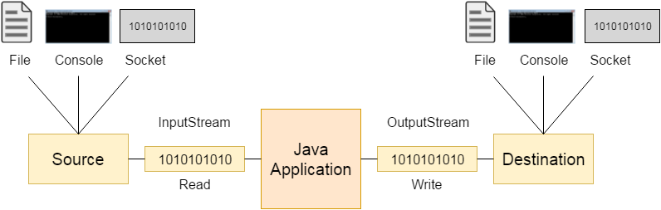
Standard I/O

Slide 4
Stream
A stream is a sequence of data. In Java a stream is composed of bytes. It's called a stream because it is like a stream of water that continues to flow. In Java, three streams are created for us automatically. All these streams are attached to the console.
1) System.out: standard output stream System.out.println(“you text”);
2) System.in: standard input stream (your keyboard)
3) System.err: standard error stream System.err.println(“you text”); ← But printed in red..lol Rarely used anymore

Slide 5
Scanner
The Scanner is a Java utility class that allows us to read user input from an input stream (the keyboard in our case). Scanner myScanner = new Scanner(System.in);
It has a method that we call nextLine() that allows us to read user input in as a String
System.out.println("Bart Simpson: Are We There Yet? (Y)es or (N)o ");
String answer = myScanner.nextLine();

Slide 6
Scanner nextLine() method
myScanner.nextLine() gets text from input stream up until a newline (the user presses Enter). The text is returned as a String and the newline is digarded. If I was typing my name on a keyboard and pressed <enter>. This is what would be captured in the input stream:
Steve\n
Hello World\n Most of the time we not want to have the \n character as this is not part of my name. The myScanner.nextLine() will read in the above and discard the \n for me

Slide 7

Are We There Yet?

Slide 8
Scanner nextInt() method
Scanner also provides methods to get the next numeric value from the stream. It gets the next characters that can be converted to the numeric data type and leaves the rest.
A newline character is not a numeric type, so it will be left on the stream. So after using methods like nextInt(), nextLine() must be called to “clean up” the newline.
int userNumber = scanner.nextInt();
scanner.nextLine();
What is your age? User → 10<enter> This is what it looks like in stream: 10\n nextInt() grabs 10 but leaves the \n character behind.
Using nextLine will grab the \n or any remaining characters from the stream and discard them because we are not assigning them to a variable, etc.

Slide 9
Parsing Strings
Data read in from Scanner.nextLine is a String. But what if we want to use nextLine and we need it in another data type? Parsing is the conversion of data between unlike data types. For example: String → int
Parse methods that can parse a string to that data type are available for each of the basic data types using their wrapper class. The String must contain characters that are valid for the data type it is being parsed into.
Data Type | Wrapper | Parse Method
int | Integer | Integer.parseInt(string)
long | Long | Long.parseLong(string)
double | Double | Double.parseDouble(string)
boolean | Boolean | Boolean.parseBoolean(string)

Slide 10
How To Handle A Series of Numbers
We can also read in a series of data values with a separator:
System.out.print(“Enter a series of human ages (separated by commas): ");
String input = scanner.nextLine();
String[] numbers = input.split(","); // note: these are String representation of numbers....
String[] numbers2 = input.split(" "); … now we can go loop through and convert to numbers/calculate dog ages… Ex: Enter a series of human ages (separated by commas): “17, 5, 20, 56”
input.split(",")
numbers
“17” | “5” | “20” | “56”

Slide 11


How Old Are You In Dog Years?

Slide 12

Parsing? Ain’t nobody got time for that!
Related Topics Formatting Command Line Arguments

Slide 13
String Formatting (Research on your own)
(padding with spaces, left justify, right-justify, decimals to x places, leading zeros, columns, etc) Two primary methods: You can format String in Java either by using the preferred String.format() which allows you to format and assign values to variables as a formatted value OR using the System.out.printf()if printing to console.
https://beginnersbook.com/2017/10/java-string-format-method/ https://stackabuse.com/how-to-format-a-string-in-java-with-examples/

Slide 14
System.out Formatting
println(string) → prints the string to the console and adds a newline print(string) → prints the string to console and does not add a newline
printf(format, data) → prints the data to the console using the provided format.
System.out.printf(“Your item is %-10s -10f”, “book”, 3.50); → adds book so that it always takes up 10 spaces
%-10s % - Starts a formatter -10 - 10 sets the size to 10, - adds any padding on the left.
s - defines the data type being formatted as a String
s – formats strings
d – formats decimal integers
f – formats the floating-point numbers
t– formats date/time values
System.out.printf(“Total Cost $%4.2f”, 4.2507); → formats 4.2507 to a total of 4 characters and 2 decimal places
%4.2f % - Starts a formatter
4.2 - sets the total size to 4 characters and .2 sets it to 2 decimal places
f - defines the data type being formatted as a floating point number
printf format cheat sheet
More info on printf in Java

Slide 15
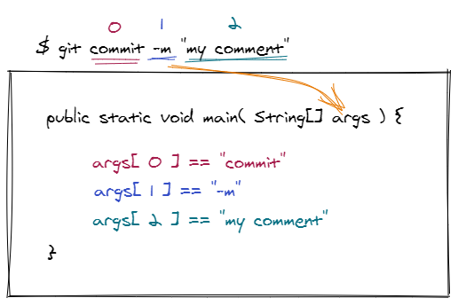
Command Line Arguments
Arguments passed on the command line to an application are populated into String[] args array of the main() method.

Slide 16
Decimal | Binary
1 | 1
2 | 10
3 | 11
4 | 100
5 | 101
6 | 110
7 | 111
8 | 1000
9 | 1001
10 | 1010

